Slide 1
(Lambda expression) {java 8;}
Duc anh (vu) Nguyen, cory huffine

Slide 2
what is lambda expression in java 8?
New language feature that was added in Java 8.
Provides a clear and simple way to represent a Functional Interface.
Does not have a function name and does not belong to any classes.
Only includes parameters and body.
Does not have scopes and no return values.

Slide 3
Lambda expression syntax in java 8
(argument-list) -> {body}
Argument-list: there can be no, one or many parameters.
Arrow-token: used to link argument-list and body of expression.
Body: contains the expressions and statements.

Slide 4
Research questions
Why is Lambda Expression implemented in programming languages?
Is it possible to implement Lambda expression on complex algorithms?

Slide 5
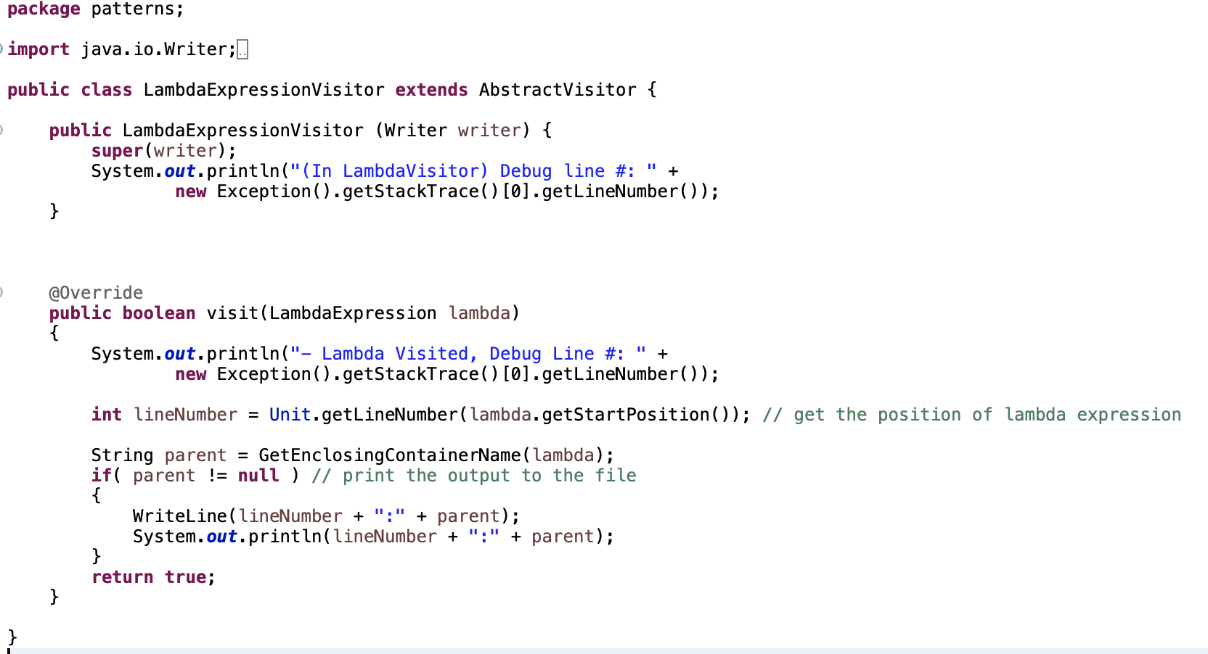
Implementation
We added a Lambda Expression Visitor used in AbstractVisitor.java and Application.java in the local Java server to detect the statement that implemented with Lambda expression in the input.

Slide 6
Programming language tools
Programming Language Static Analysis tools:
Java Local Server: Uses visitor to determine the implementations of Lambda expression in the open-source projects.
Python Clients: Counts the uses of Lambda expression in the input, connects the databases with the working server, parsed through revisions and lambda expression tables.
MySQL Database: Stores the relevant data extracted from the open-source project. Selected data about lambda expression will be analyzed later.

Slide 7
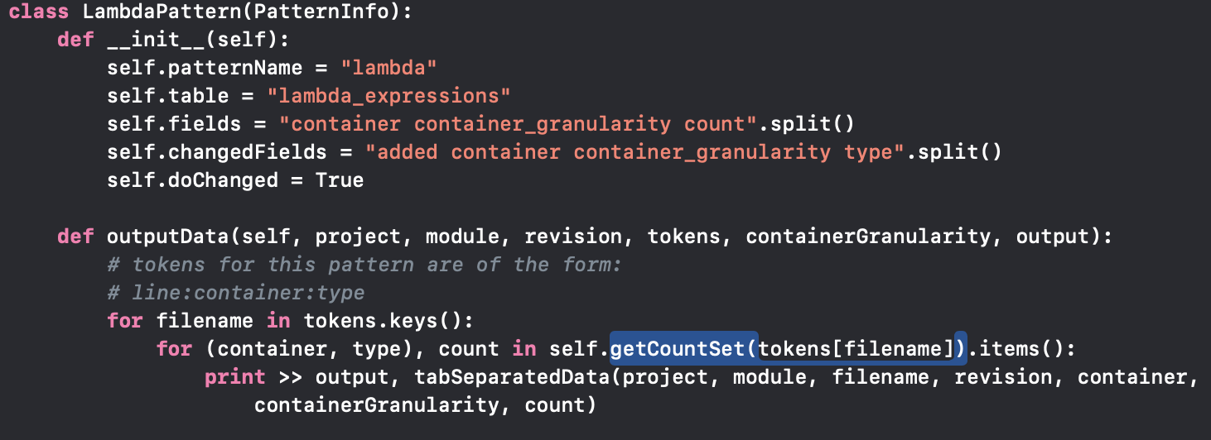
Implementation
We added a Lambda Expression Visitor used in AbstractVisitor.java and Application.java in the local Java server to detect the statement that implemented with Lambda expression in the input.
Class LamdaPattern was added to run.py to output the number of lambda expressions for each line.

Slide 8
Implementation
We added a Lambda Expression Visitor used in AbstractVisitor.java and Application.java in the local Java server to detect the statement that implemented with Lambda expression in the input.
Class LamdaPattern was added to run.py to output the number of lambda expressions for each line then we use MySQL to insert the output data to the databases;
All the data was exported directly from revisions.sql and lambda_expressions.sql to a .tsv output file and was parsed through by a .tsv reader in lambdas_over_time.py
Date time and the number of lambda expressions implemented in the open-source projects are output, allowing us to graph total usage over time.

Slide 9
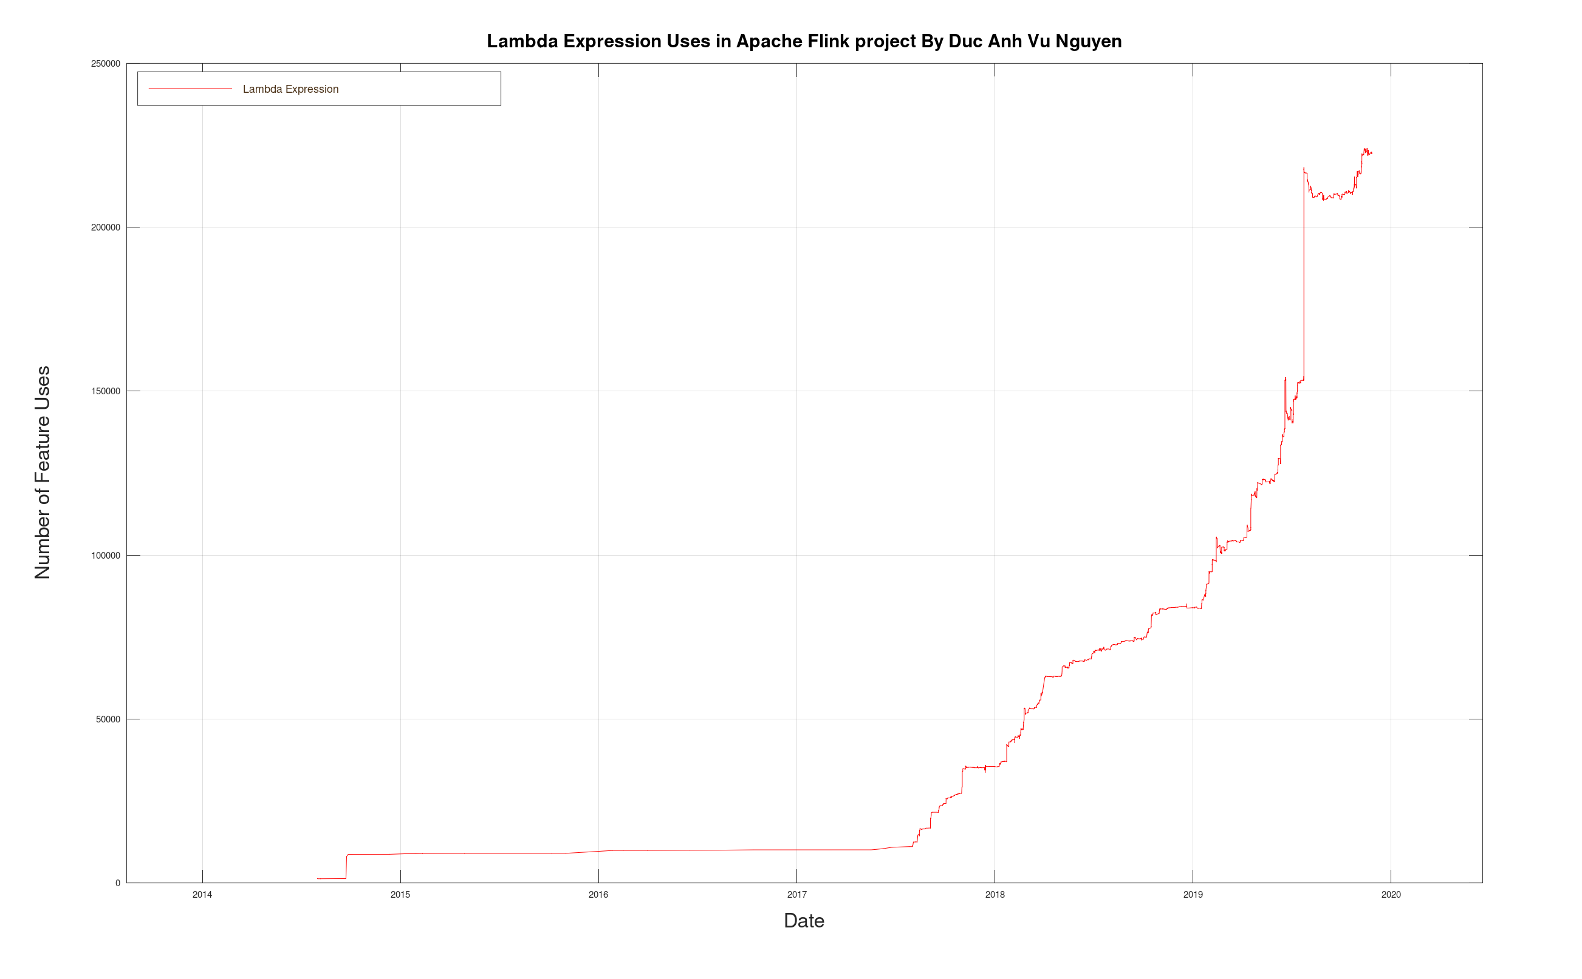
1.29M lines of code

Slide 10
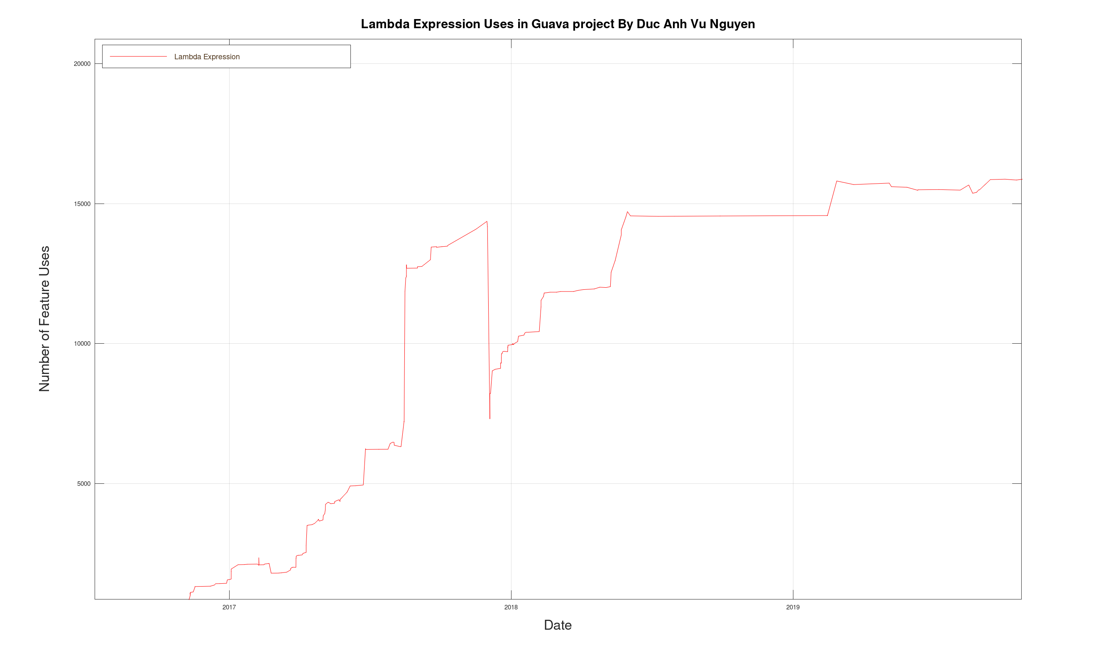
517k lines of code

Slide 11
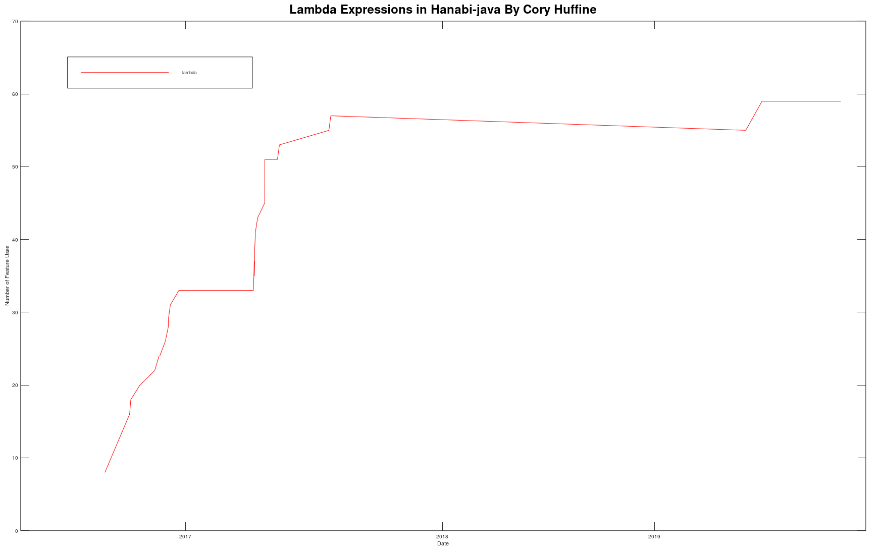
26.3k lines of code

Slide 12
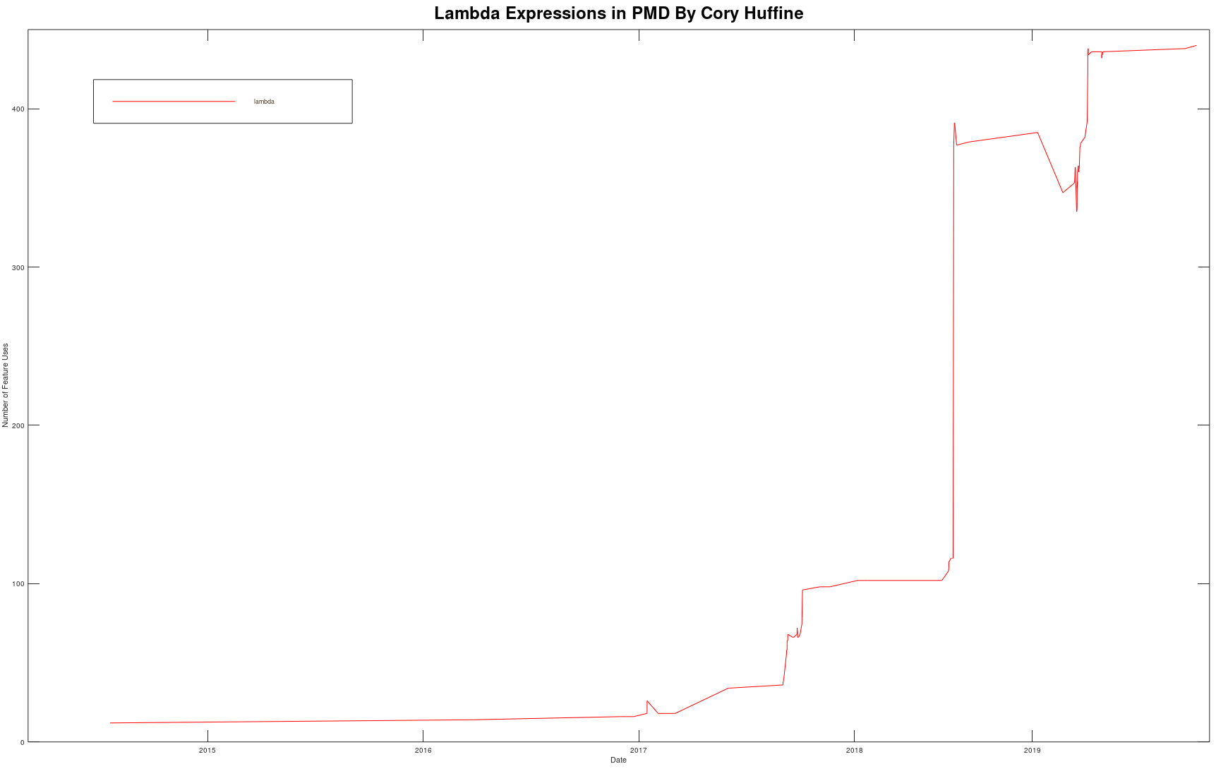

Slide 13
Conclusion

Slide 14
Why is Lambda Expression implemented in programming languages?
Reduce lines of code.
Sequential and Parallel Execution Support by passing behavior in methods
Notes:
Prior to Java 8, processing the elements of any collection could be done by obtaining an iterator from the collection and then iterating over the elements and then processing each element. If the requirement is to process the elements in parallel, it would be done by the client code. With the introduction of Stream API in Java 8, functions can be passed to collection methods and now it is the responsibility of collection to process the elements either in a sequential or parallel manner.

Slide 15
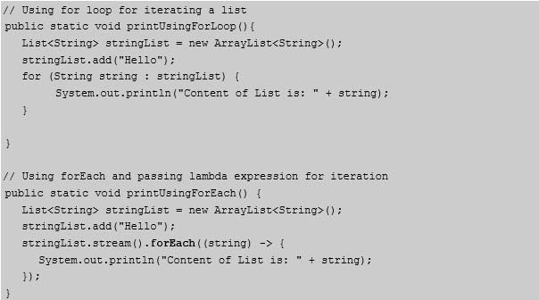

Slide 16
Why is Lambda Expression implemented in programming languages?
Reduce lines of code.
Sequential and Parallel Execution Support by passing behavior in methods
Higher Efficiency (Utilizing Multicore CPU’s)
Notes:
Using Stream API’s and lambda expression we can achieve higher efficiency (parallel execution) in case of bulk operations on collections.
Also, the lambda expressions can help in achieving internal iteration of collections rather than external iteration as shown in the above example.
As nowadays we have CPUs with multicores, we can take advantage of these multicore CPU’s by parallel processing of collections using lambda.

Slide 17
Is it possible to implement Lambda expression on complex algorithms?
Lambda is difficult to be implemented in the complex methods or functions.
Lambda will reduce the readability of the code in the more complicated methods when the programmers don’t always have the source of the libraries they are using.
Take more time to understand the codes if you are not used to them and don’t really know the library you are using with Lambda expression to reduce lines of code.
If you have to quickly determine what the code is doing, especially the complex algorithms, the abstraction brought in by lambdas, even as it simplifies the Java syntax, will be hard to understand quickly and easily.
Notes:
Spending some quiet hours understand
the 10 lines of code combined in 1 or 2 lines of codes by Lambda expression

Slide 18
Despite the confusion over syntax and the cost of readability, Lambda expressions allow the experienced programmer to greatly increase their productivity and are a valuable addition to any language.
Notes:
Everything has good and bad, it depends a lot on the context – you wouldn’t want to drive a cement truck to the supermarket for a bottle of milk?

